Slide 1
Data Visualization Project
Subject: 47451 Data Visualization
Name: Cara
Student ID: 10890021
Date: 2024/12/31

Slide 2
Data Visualization Problem 1:
What is the problem you want to solve in data analysis?
What are the salary differences based on experience levels, employment types, or work modes…?
What is the dataset for data analysis?
data_science_salaries
What is the download link URL? (Please clearly marked the download URL link of your dataset)
https://www.kaggle.com/datasets/sazidthe1/data-science-salaries/data

Slide 3
Data Visualization Problem 1:
Which tool do you use to visualize the results of your data analysis?
Python
Tableau
What is the file name?
Python: 10890021_DataVisualization_Project.py
Tableau: 10890021_DataVisualization_Project.twbx

Slide 4
Data Visualization Problem:
Reasons for choosing Python
Flexibility and powerful data processing capabilities
Diverse visualization function library
Stylized workflow
Reasons for choosing Tableau
Highly interactive
Quickly create a chart
Powerful integration capabilities

Slide 5
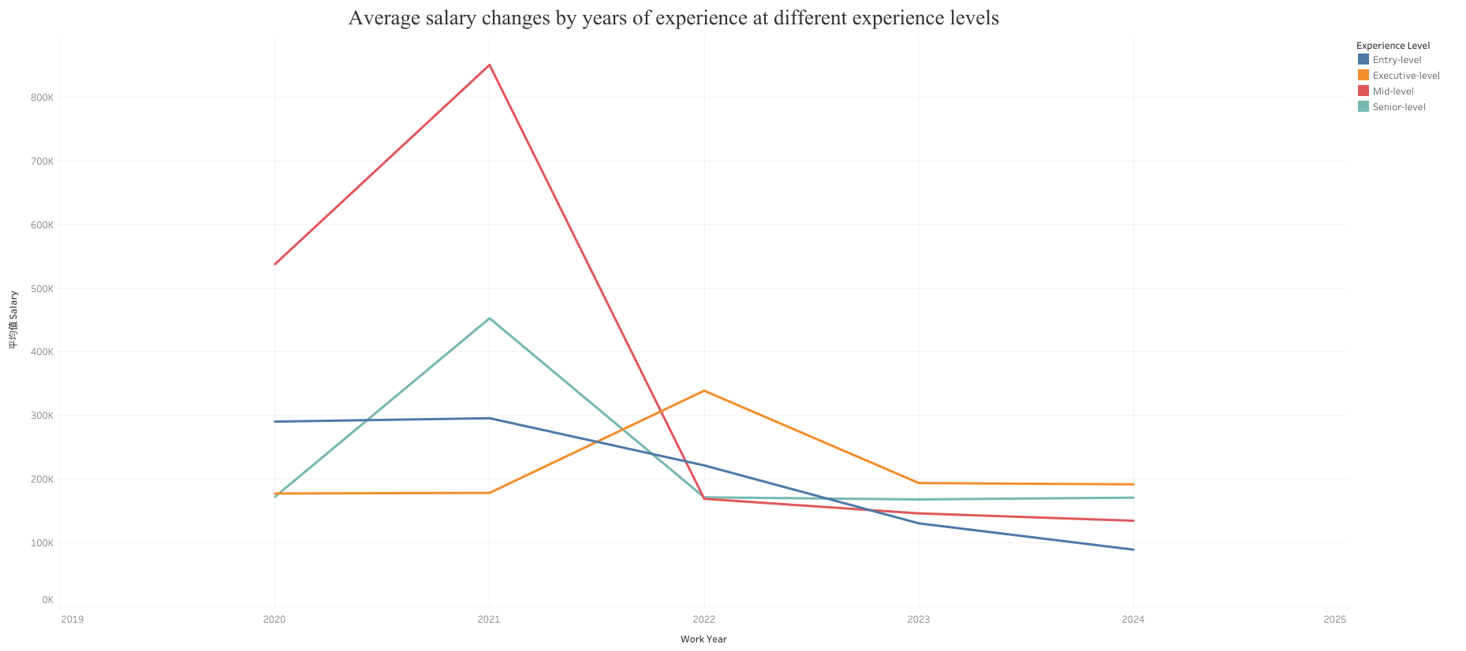
Tableau visualization charts

Slide 6
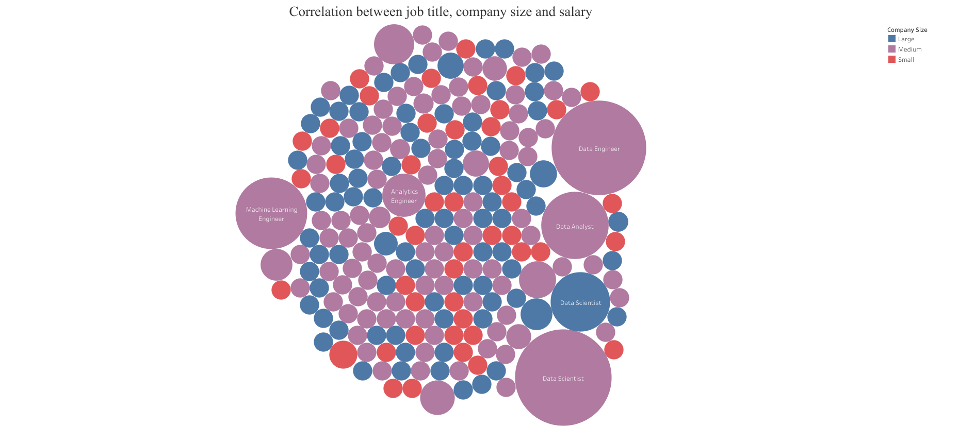
Tableau visualization charts

Slide 7
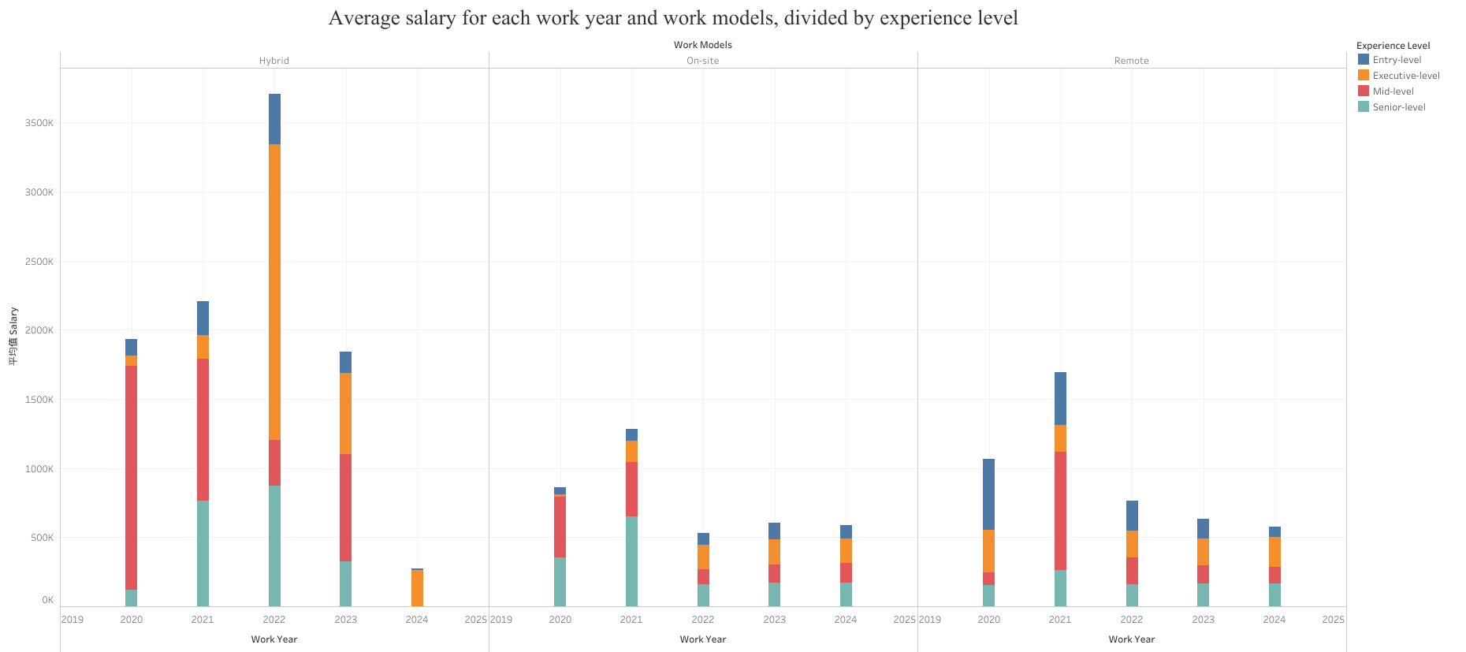
Tableau visualization charts

Slide 8
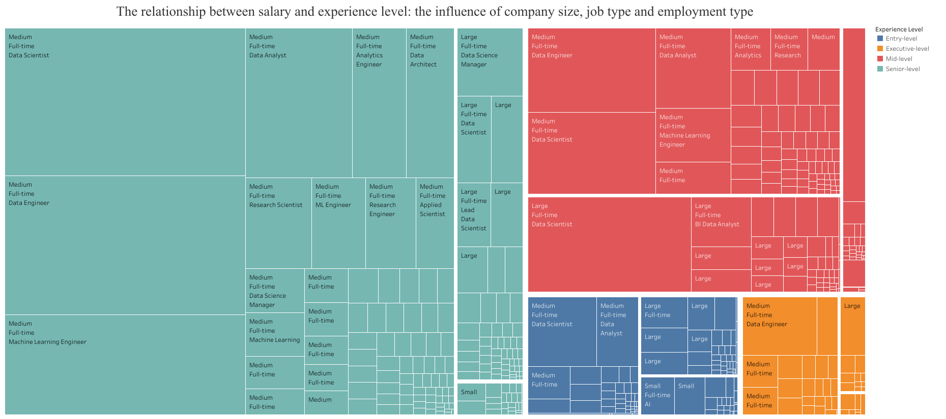
Tableau visualization charts

Slide 9
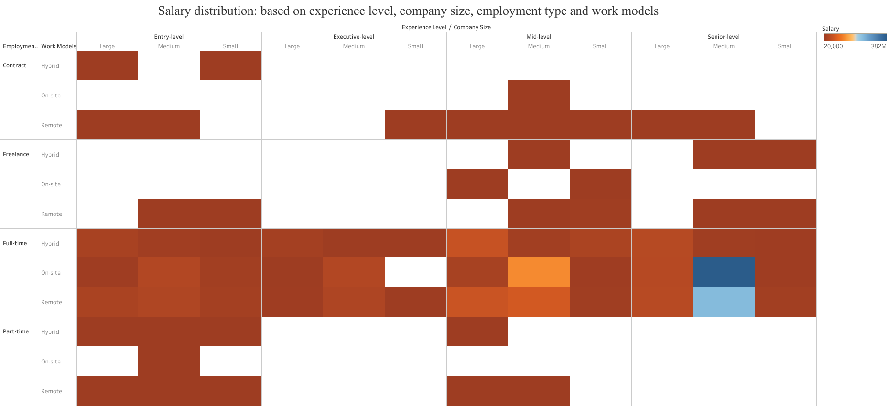
Tableau visualization charts

Slide 10
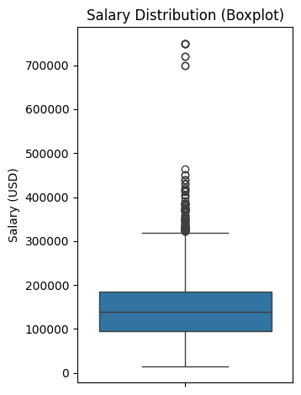
Python visualization charts

Slide 11
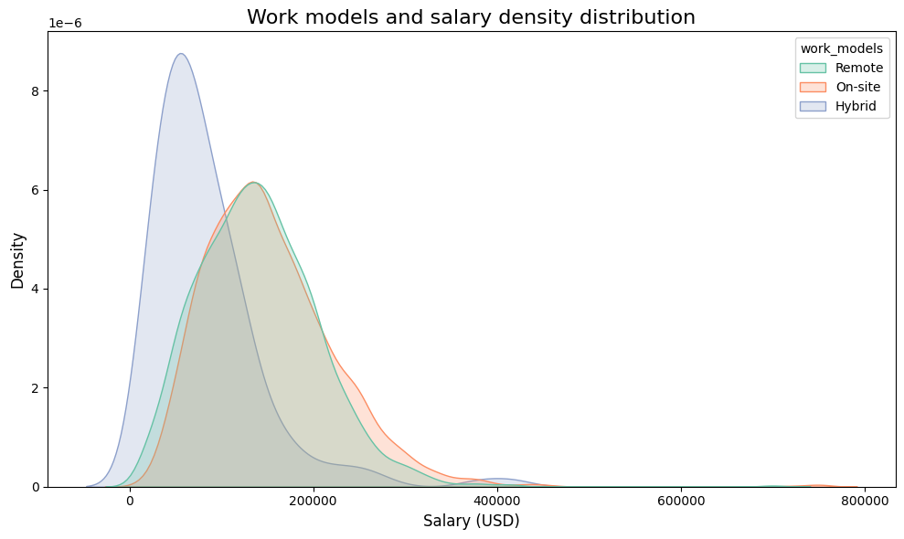
Python visualization charts

Slide 12
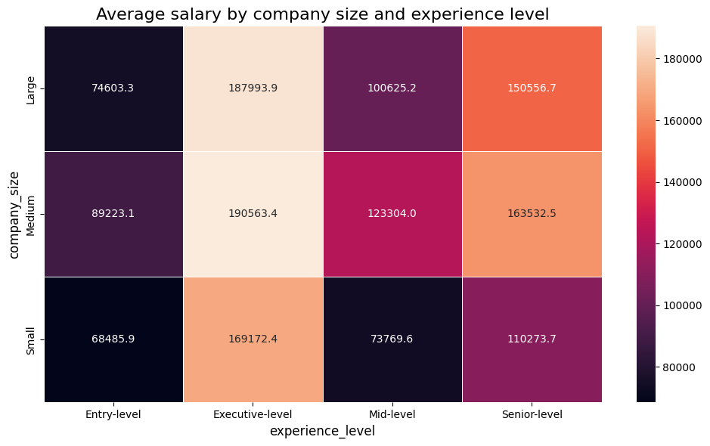
Python visualization charts

Slide 13
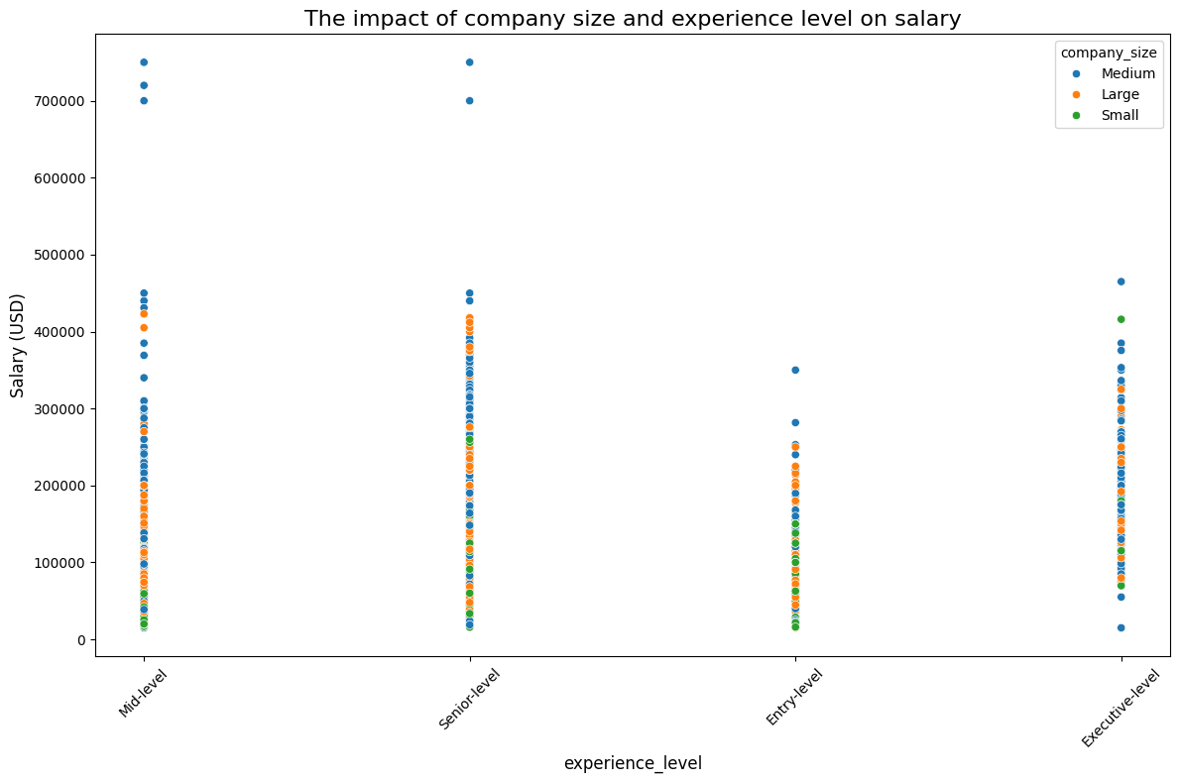
Python visualization charts

Slide 14
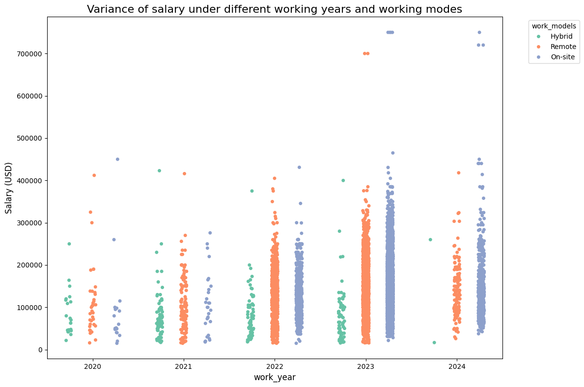
Python visualization charts

Slide 15
Conclusion
What is the conclusion of data analysis insights obtained through visual charts?
Salary changes by year: Salary changes in different years help understand market demand and show whether salaries are growing or stable
The impact of company size on salary: Some mid-sized companies may offer higher salaries than larger companies.

